Slide 1
实时收集，海量日志分析平台 ELK 搭建
Author:tpeng
Date:2018.01.17
Mail: 398222836@qq.com

Slide 2
Elasticsearch
全文搜索属于最常见的需求，开源的 Elasticsearch （以下简称 Elastic）是目前全文搜索引擎的首选。
它可以快速地储存、搜索和分析海量数据。维基百科、Stack Overflow、Github 都采用它。
Elastic 的底层是开源库 Lucene。但是，你没法直接用 Lucene，必须自己写代码去调用它的接口。Elastic 是 Lucene 的封装，提供了 REST API 的操作接口，开箱即用。

Slide 3

一、安装
jdk环境准备，安装最新版，需要1.8版本以上， 网上很多资料，在次不做过多赘述
172.20.8.215
wget https://artifacts.elastic.co/downloads/elasticsearch/elasticsearch-6.1.2.tar.gz
tar -xvf elasticsearch-6.1.2.tar.gz
vi elasticsearch.yml
cluster.name: my-search
node.name: node-1
path.data: /export/data/elastic/data
path.logs: /export/data/elastic/logs
network.host: 0.0.0.0
http.port: 9200
discovery.zen.ping.unicast.hosts: ["172.20.8.215","172.20.10.200"]
discovery.zen.minimum_master_nodes: 1
node.master: true
node.data: true
http.cors.enabled: true
http.cors.allow-origin: "*"

Slide 4
cd elasticsearch-6.1.2/bin
./elasticsearch
或者nohup ./elasticsearch &
如果报以下错误：

Slide 5
[1]: max file descriptors [4096] for elasticsearch process is too low, increase to at least [65536]
vi /etc/security/limits.conf
* hard nofile 65536
* soft nofile 65536
重启生效
[2]: max virtual memory areas vm.max_map_count [65530] is too low, increase to at least [262144]
vi /etc/sysctl.conf
vm.max_map_count=262144
sysctl -p #生效

Slide 6
如果一切正常，新开窗口，curl localhost:9200
返回如下内容：
{
"name" : "AJiUzWn",
"cluster_name" : "elasticsearch",
"cluster_uuid" : "Vx_nCTW1Q8CoMHGuRMR13w",
"version" : {
"number" : "6.1.2",
"build_hash" : "5b1fea5",
"build_date" : "2018-01-10T02:35:59.208Z",
"build_snapshot" : false,
"lucene_version" : "7.1.0",
"minimum_wire_compatibility_version" : "5.6.0",
"minimum_index_compatibility_version" : "5.0.0"
},
"tagline" : "You Know, for Search"
}

Slide 7
以上内容包含 当前节点，集群，版本等信息
Ctrl+c ，会停止运行。
默认情况下，Elastic 只允许本机访问，如果需要远程访问，可以修改 Elastic 安装目录的config/elasticsearch.yml文件，去掉network.host的注释，将它的值改成0.0.0.0，然后重新启动 Elastic。
network.host: 0.0.0.0
上面代码中，设成0.0.0.0让任何人都可以访问。线上服务不要这样设置，要设成具体的 IP。
防火墙关闭或开放9200端口

Slide 8
Head 插件安装
一、下载插件
wget https://github.com/mobz/elasticsearch-head/archive/master.zip
unzip master.zip
二、安装node
wget https://npm.taobao.org/mirrors/node/latest-v9.x/node-v9.0.0-linux-x64.tar.gz
tar -zxvf node-v9.0.0-linux-x64.tar.gz
vi /etc/profile
export NODE_HOME=/export/servers/node-v9.0.0-linux-x64
export PATH=$NODE_HOME/bin:$PATH
export NODE_PATH=$NODE_HOME/lib/node_modules
source /etc/profile

Slide 9
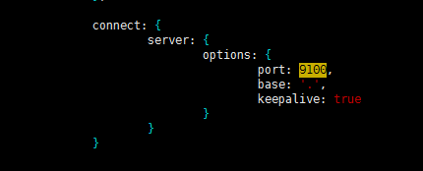
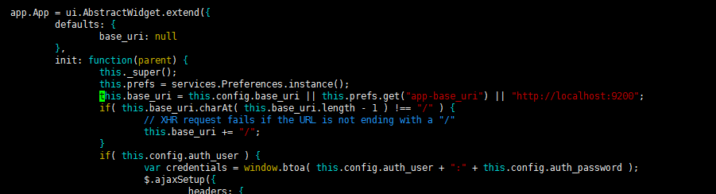
三、安装grunt
su - root
npm install -g grunt-cli
修改服务器监听地址:Gruntfile.js
修改连接地址：_site/app.js

Slide 10
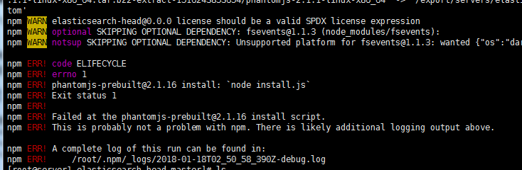
cd elasticsearch-head-master/
npm install
在运行npm install时，可能会存在Head插件phantomjs权限问题：
解决方法,在npm install命令后加 -g 参数：
npm install -g
grunt server

Slide 11
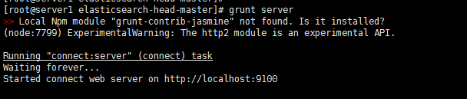
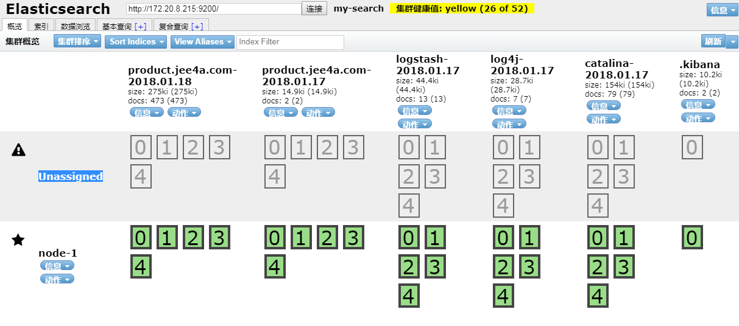
客户端浏览器输入：
http://172.20.8.215:9100/

Slide 12
Logstash 安装
172.20.10.200
wget https://artifacts.elastic.co/downloads/logstash/logstash-6.1.2.tar.gz
tar -zxvf logstash-6.1.2.tar.gz
vi product.jee4a.com.conf

Slide 13
input {file{
type =>"product.jee4a.com"
path =>"/export/home/tomcat/domains/product.jee4a.com/server1/logs/catalina.out"
} }
output {
elasticsearch {
index => "product.jee4a.com-%{+YYYY.MM.dd}"
hosts => ["172.20.8.215:9200"] }
stdout { codec => rubydebug }
}
bin/logstash -f product.jee4a.com.conf

Slide 14
Kibana 安装
172.20.8.215
wget https://artifacts.elastic.co/downloads/kibana/kibana-6.1.2-linux-x86_64.tar.gz
tar -zxvf kibana-6.1.2-linux-x86_64.tar.gz
cd kibana-6.1.2-linux-x86_64/
vi config/kibana.yml
server.port: 5601
server.host: "0.0.0.0“
elasticsearch.url: http://localhost:9200
启动
bin/kibana

Slide 15
-bash-4.2$ bin/kibana
log [08:10:58.681] [info][status][plugin:kibana@6.1.2] Status changed from uninitialized to green - Ready
log [08:10:58.725] [info][status][plugin:elasticsearch@6.1.2] Status changed from uninitialized to yellow - Waiting for Elasticsearch
log [08:10:58.750] [info][status][plugin:console@6.1.2] Status changed from uninitialized to green - Ready
log [08:10:58.782] [info][status][plugin:elasticsearch@6.1.2] Status changed from yellow to green - Ready
log [08:10:58.792] [info][status][plugin:metrics@6.1.2] Status changed from uninitialized to green - Ready
log [08:10:58.948] [info][status][plugin:timelion@6.1.2] Status changed from uninitialized to green - Ready
log [08:10:58.953] [info][listening] Server running at http://0.0.0.0:5601
浏览器：
http://172.20.8.215:5601

Slide 16
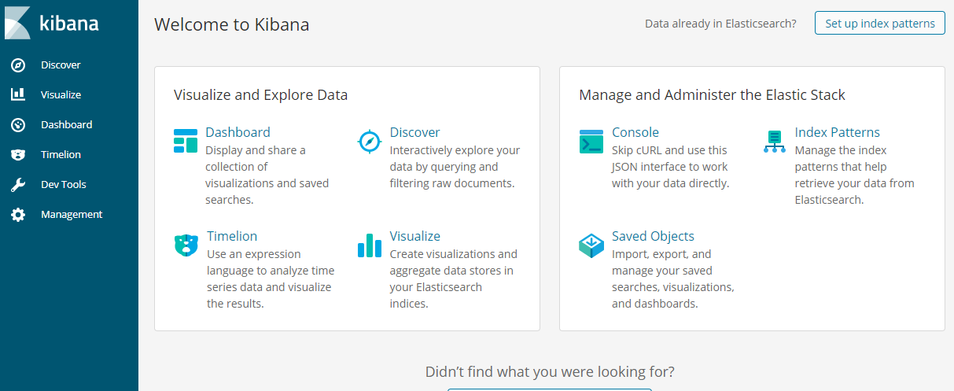

Slide 17
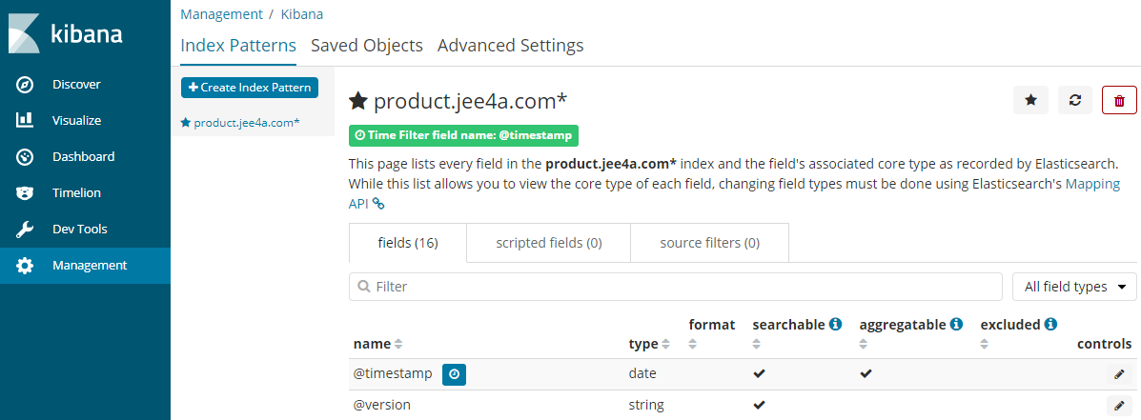
创建索引模式

Slide 18
测试用例
延用服务提供方程序 jee4a-dubbo-provider
log4j.xml 配置
<appender name="socketAppender" class="org.apache.log4j.net.SocketAppender">
<param name="remoteHost" value="localhost" />
<param name="port" value="4560" />
<param name="Threshold" value=“ERROR" />
<param name="ReconnectionDelay" value="1000" />
<param name="LocationInfo" value="true" />
</appender>
<root>
<priority value="error" />
<appender-ref ref="console" />
</root>

Slide 19
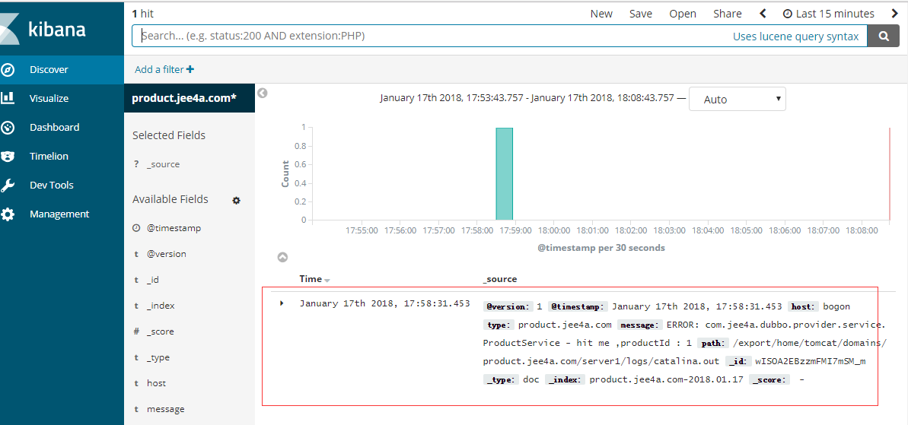
运行消费房测试用例产生日志

Slide 20
elasticsearch集群
172.20.10.200
vi elasticsearch.yml
cluster.name: my-search
node.name: node-2
path.data: /export/data/elastic/data
path.logs: /export/data/elastic/logs
network.host: 0.0.0.0
http.port: 9200
discovery.zen.ping.unicast.hosts: ["172.20.8.215","172.20.10.200"]
discovery.zen.minimum_master_nodes: 1
node.master: false
node.data: true
http.cors.enabled: true
http.cors.allow-origin: "*“
启动
bin/elasticsearch

Slide 21
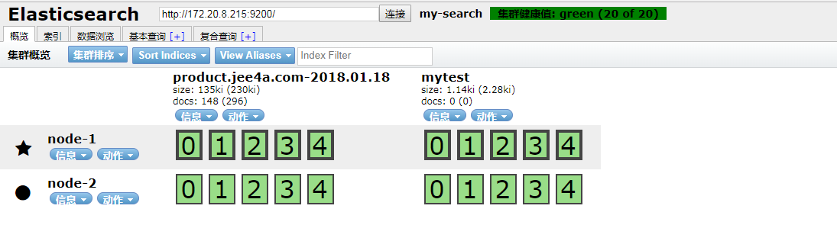

Slide 22
参考资料
https://www.elastic.co/
https://github.com/mobz/elasticsearch-head
https://www.cnblogs.com/Onlywjy/p/Elasticsearch.html
https://npm.taobao.org/mirrors/node/latest-v9.x/
https://www.cnblogs.com/sunxucool/p/3799190.html
https://www.cnblogs.com/blogjun/articles/82fb37eb418a2ed8dc6adf3d306aa2ef.html
https://www.cnblogs.com/aubin/p/8012840.html

